Slide 1
CS 4530: Fundamentals of Software Engineering Activities for Week 5: Project Teams, Test Doubles
Jonathan Bell, Adeel Bhutta, Ferdinand Vesely, Mitch Wand
Khoury College of Computer Sciences
© 2022 Released under the CC BY-SA license

Slide 2

Pre-Lesson 5.1 Activity: Team Introductions
Let the class divide themselves in groups (move around the room or join Break rooms) to get to know each other
Give them a few minutes to exchange contact information, share schedules, etc.
Reach out to those not in attendance
Mentors should say a quick Hi and exchange contact information
Notes:
<read slide>
Mentors should introduce themselves to each group and exchange contact info for setting up Mandatory Kick-off meeting
Instructor should say Hi to all groups (either by walking around and talking to each group or by making announcement in class) <Anticipate 10-15 minutes for students to move around, get organized and exchange contact info> <30-45 minutes for TA/Instructor to meet with each team>

Slide 3
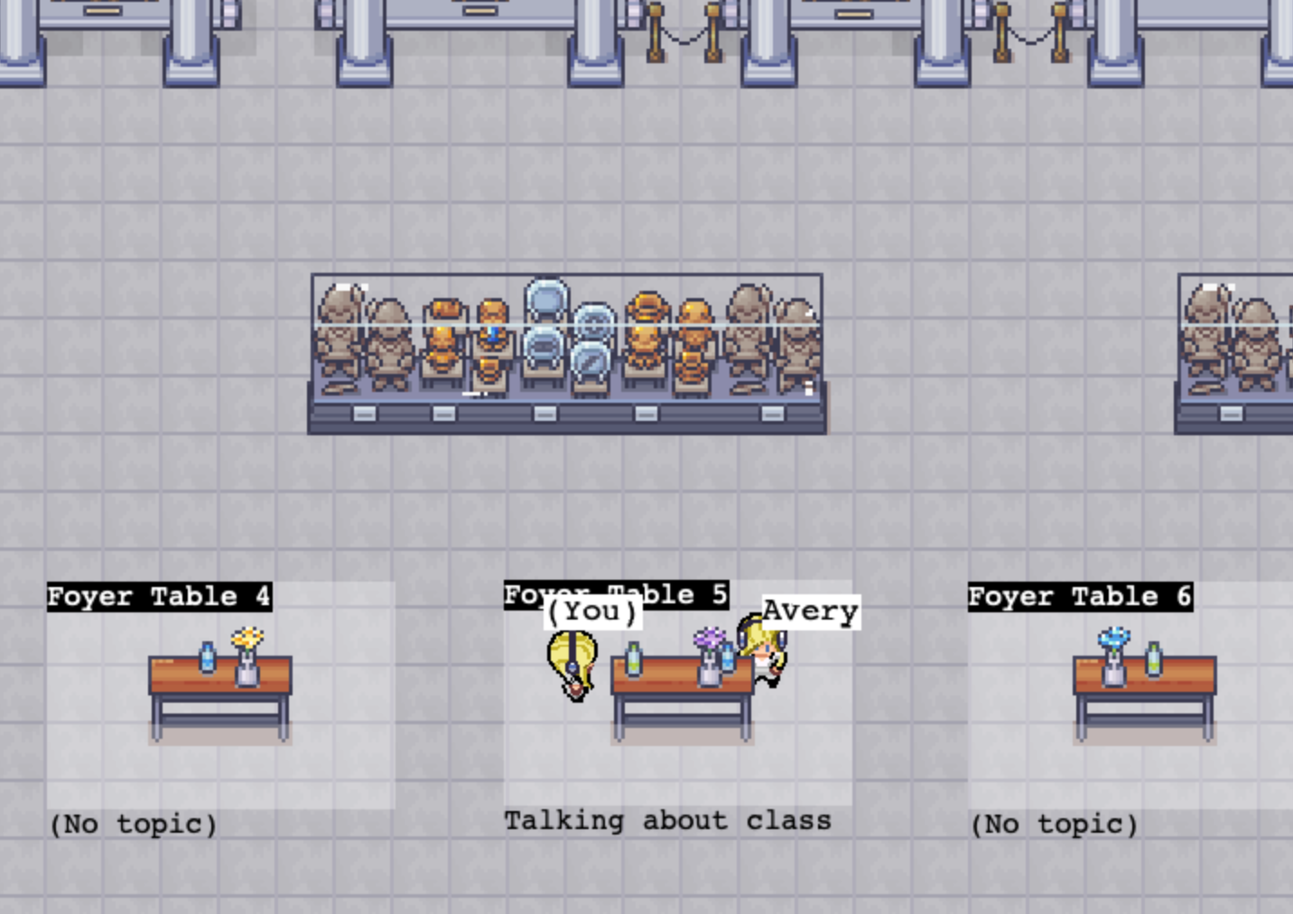
Lesson 5.3 Activity: Mocks and Spies
Review Testing Tutorial
HW2 was quite an introduction to Covey.Town: “Conversation Areas”
Do a quick walk through the code and see if you can find any Mocks and Spies being used.
Provide two examples and briefly explain how they are being used.
Notes:
<read slide>
Give this ~15 minutes for work, 5 minutes for discussion or sharing

